Slide 1

Hadoop: Basic Concepts
Hadoop File System
Mohd Hasnain - MCHD - MapR Certified Hadoop Developer
(550574 | Mobile: +91 987 173 4819 )
AXP Internal

Slide 2
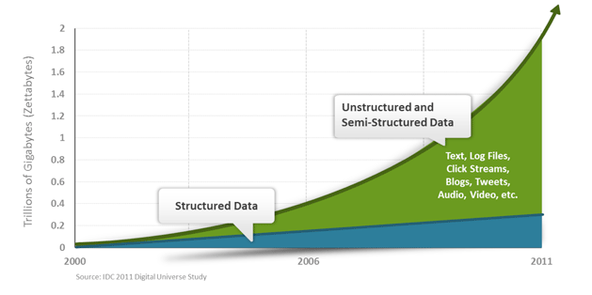
Data Worth Storing?
Transitions
Logs
Business
User
Sensor
Medical
Social
Sports
- etc ..
--- BigData Caught Flirting Everywhere
- Save Data for Future Use (Instead of Use and Discard)
AXP Internal

Slide 3
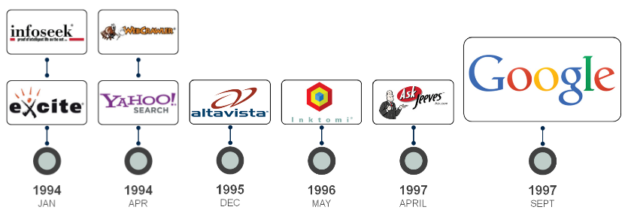
Hadoop - Doug cutting’s sons toy elephant
MapReduce - Part of open source project nutch
AXP Internal

Slide 4

AXP Internal

Slide 5
Germany's World Cup tactics: shaped by data
“In just 10 minutes, 10 players with three balls can produce over seven million data points”
    Oliver Bierhoff, brand ambassador for German software maker SAP AG and manager of the German national football team, told a press conference in Brazil earlier this week.
Dump data - Ingest and Store Data in Original Format – No ETL ?
Transform Data when ready and move to EDW - Reduced 90% EDW cost
Moore's law
Ex. Recommendation Engine, Competitor price
Predictive Analytics
Parallel Processing
AXP Internal

Slide 6
Big Data Problem
- ‘Big-data’ is similar to ‘Small-data’, but bigger
3VS
VOLUME – TOO BIG
VELOCITY – TOO QUICK
VARIETY – TOO VARIABLE
-ANY ABOVE COMBINATION
AXP Internal

Slide 7
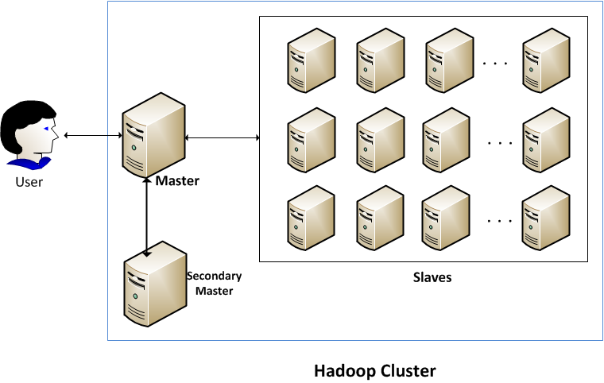
Cluster
-Parallel Processing – Divide and conquer
AXP Internal

Slide 8
Metadata “data about data"
data that describes other data
  Encryption type
  Data path, file path
  User group/access/author
  Replication factor
  Content type
  block size/file size
  Date created/modified
    Etc …
AXP Internal

Slide 9
Hadoop Distributed Filesystem: HDFS
Commodity hardware
Highly fault-tolerant – Failure is norm rather then exception
Very Large Files– GB/TB/PB/ZB
Streaming data access – Write once/read many times
Scalability
Distributed storage system
- If one break down add another
- If more data add another
High throughput – low latency data access
Lots of small files
Multiple writers, arbitrary file modifications
AXP Internal

Slide 10
WARNING: Do not attempt to modify metadata directories or files. Unexpected modifications can cause HDFS downtime, or even permanent data loss. This information is provided for educational purposes only.
AXP Internal

Slide 11
Data Blocks
Minimum amount of data that it can read or write
64MB by default (or even 128 MB) – independent units
All blocks in the file except the last are of the same size
A file is chopped into 64MB chunks and stored with replication
- fault tolerance
Block size and replicas are configurable per file
Why Block in HDFS is so Large ?
- minimize the cost of seeks
- large block, the time to transfer the data from the disk can be made to be significantly larger than the time to seek to the start of the block
- seek time is around 10 ms, and the transfer rate is 100 MB/s, then to make the seek time 1% of the transfer time?
Map tasks in MapReduce normally operate on one block at a time
AXP Internal

Slide 12
FSCK – health of files in HDFS
% hadoop fsck /
......................Status: HEALTHY
Total size: 511799225 B
Total dirs: 10
Total files: 22
Total blocks (validated): 22 (avg. block size 23263601 B)
Minimally replicated blocks: 22 (100.0 %)
Over-replicated blocks: 0 (0.0 %)
Under-replicated blocks: 0 (0.0 %)
Mis-replicated blocks: 0 (0.0 %)
Default replication factor: 3
Average block replication: 3.0
Corrupt blocks: 0
Missing replicas: 0 (0.0 %)
Number of data-nodes: 4
Number of racks: 1
The filesystem under path '/' is HEALTHY
% hadoop fsck /user/tom/part-00007 -files -blocks -racks
/user/tom/part-00007 25582428 bytes, 1 block(s): OK
0. blk_-3724870485760122836_1035 len=25582428 repl=3 [/default-rack/10.251.43.2:50010,
/default-rack/10.251.27.178:50010, /default-rack/10.251.123.163:50010]
Corrupt or missing blocks are the biggest cause for concern
AXP Internal

Slide 13
Namenode and Datanodes
Master/slave architecture
Namenode – NN - manages the file system namespace
NN receives a Heartbeat and BlockReport from each DN
BlockReport contains all the blocks on a DN
fsimage – file contains the complete state of the file system at a point in time. fsimage is file system state after all modifications up to a specific transaction ID
fsimage not updated for every filesystem write operation, since writing out the fsimage file, which can grow to be gigabytes in size, would be very slow
edits – An edits file is a log that lists each file system change (file creation, deletion or modification) that was made after the most recent fsimage
DataNodes – DN - workhorses
serves read, write requests, performs block creation, deletion, and replication upon instruction from NN
AXP Internal

Slide 14
NN dir structure
${dfs.name.dir}/current/VERSION
/edits
/fsimage
/fstime
DN dir structure
${dfs.data.dir}/current/VERSION
/blk_<id_1>
/blk_<id_1>.meta
/blk_<id_2>
/blk_<id_2>.meta
/...
/blk_<id_64>
/blk_<id_64>.meta
/subdir0/
/subdir1/
/...
/subdir63/
AXP Internal

Slide 15
Problem – NN - SPOF
If edits file would grow without bound
secondary NN – SNN – Not a NN
periodically merge the namespace image with the edit log to prevent the edit log from becoming too large
SNN copy of the merged namespace image, which can be used in the event of the NN failing
SNN lags that of the primary, so in the event of total failure of the primary, data loss is almost certain
The primary has an up-to-date fsimage file
A shorter edits file - it is not necessarily empty???
Safe Mode - if the NN were restarted, it would take a long time to apply each of the operations in its (very long) edit log. During this time, the filesystem would be offline (read only), which is generally undesirable.
AXP Internal

Slide 16
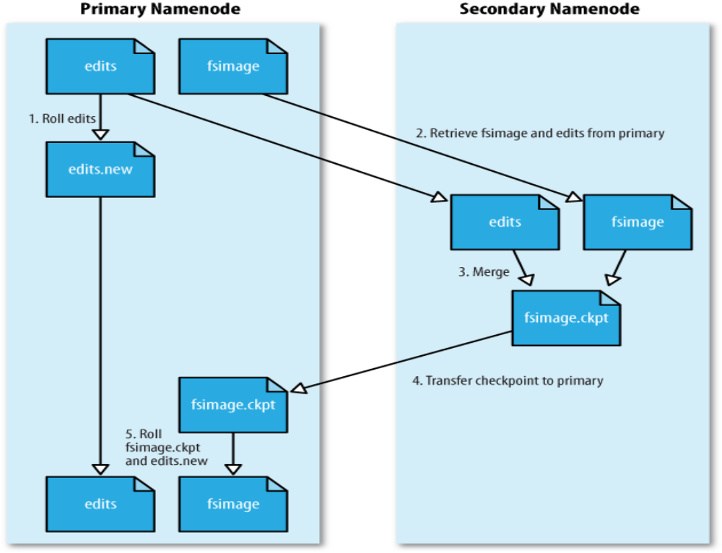
AXP Internal

Slide 17
SNN dir structure
${fs.checkpoint.dir}/current/VERSION
/edits
/fsimage
/fstime
/previous.checkpoint/VERSION
/edits
/fsimage
/fstime
3 way to start:
Manual by hadoop dfsadmin –saveNamespace
Every hour (fs.checkpoint.period in seconds)
Edit log has reached 64 MB (fs.checkpoint.size in bytes)
AXP Internal

Slide 18
HDFS Federation – 2.x release
- scale by adding NN, each of which manages a portion of the filesystem namespace
If NN fails: - New NN requires 3 to leave SAFE Mode > 30 min
loaded its namespace image into memory
replayed its edit log
received enough block reports from the DN
HDFS High-Availability – 2.x relese
Standby NN ~ 10 sec
NNs must use highly-available shared storage to share the edit log
DN must send block reports to both NNs
Clients must be configured to handle NN failover
But still ~ 1 min ??? Fencing - STONTH
AXP Internal

Slide 19
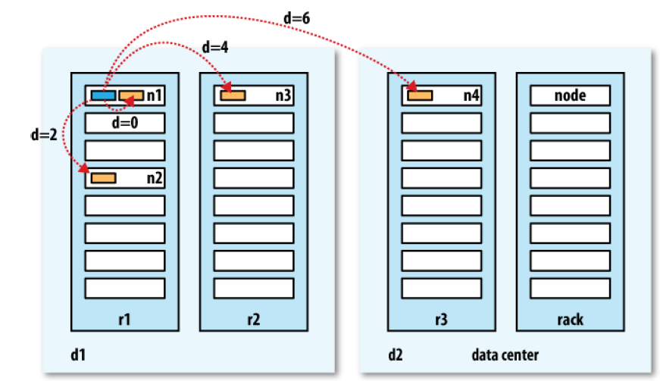
Network distance in Hadoop
AXP Internal

Slide 20
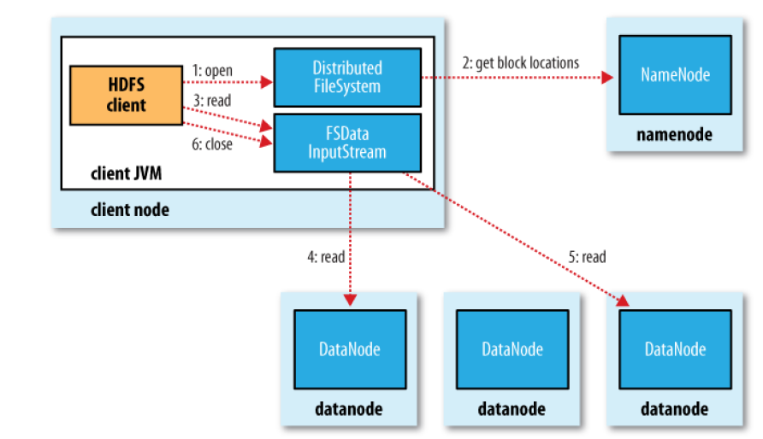
Anatomy of a File Read
AXP Internal

Slide 21
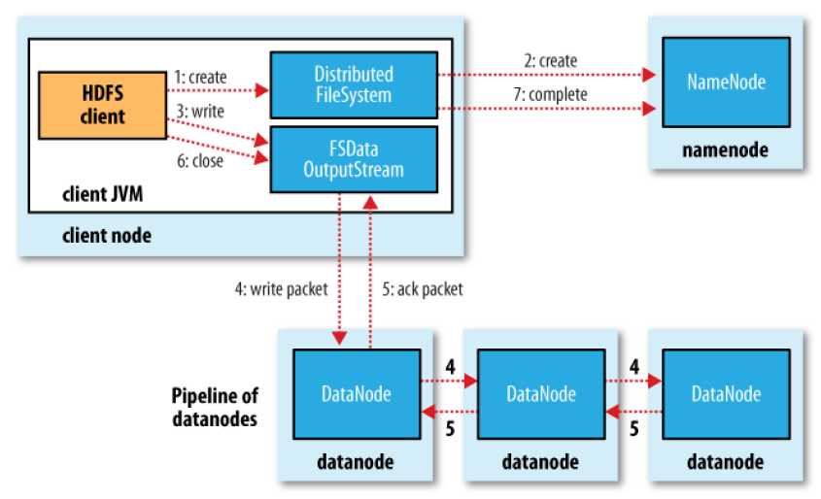
Anatomy of a File Write
AXP Internal

Slide 22
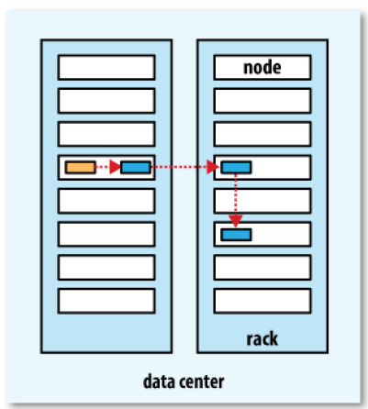
A typical replica pipeline
AXP Internal

Slide 23
CLI
-bash-4.1$ hadoop fs -help
Usage: hadoop fs [generic options]
[-cat [-ignoreCrc] <src> ...]
[-chmod [-R] <MODE[,MODE]... | OCTALMODE> PATH...]
[-copyFromLocal <localsrc> ... <dst>]
[-copyToLocal [-ignoreCrc] [-crc] <src> ... <localdst>]
[-count [-q] <path> ...]
[-du [-s] [-h] <path> ...]
[-get [-ignoreCrc] [-crc] <src> ... <localdst>]
[-getmerge [-nl] <src> <localdst>]
[-ls [-d] [-h] [-R] [<path> ...]]
[-mkdir [-p] <path> ...]
[-moveFromLocal <localsrc> ... <dst>]
[-moveToLocal <src> <localdst>]
[-mv <src> ... <dst>]
[-put <localsrc> ... <dst>]
[-rm [-f] [-r|-R] [-skipTrash] <src> ...]
[-rmdir [--ignore-fail-on-non-empty] <dir> ...]
[-tail [-f] <file>]
AXP Internal

Slide 24
hadoop fs -ls /smith/dp/dataengine/price_link_model_nbr
hlsl /smith/dp/dataengine/price_link_model_nbr | wc –l
hcat /smith/dp/dataengine/price_link_model_nbr/part-m-00000 | wc –l
hadoop fs -cat /smith/dp/dataengine/price_link_model_nbr/part-m-00000 | wc –l
hadoop fs -count /smith/dp/dataengine/price_link_model_nbr
hadoop fs -du -s -h /smith/dp/dataengine/price_link_model_nbr
hadoop fs –df
hadoop fs -mkdir /user/mhasnai/kmart_hier_report157
hadoop fs -put test.txt /user/mhasnai/kmart_hier_report157/test1
hadoop fs -rm /user/mhasnai/kmart_hier_report157/test1
hadoop fs -copyFromLocal input/docs/quangle.txt hdfs://localhost/user/tom/quangle.txt
Same hadoop fs -copyToLocal quangle.txt quangle.copy.txt
To list the files in the root directory of the local filesystem, type:
hadoop fs -ls file:///
Parallel Copying with distcp – runs MR
hadoop distcp hdfs://namenode1/foo hdfs://namenode2/bar
AXP Internal

Slide 25
Hadoop Archives - .har
large number of small files - memory of NN - ???
archive tool - runs a MR job to process the input files in parallel
To add or remove files, you must re-create the HAR
HAR creates a copy of the original files
HAR can be used as input to MapReduce. However, there is no archive-aware InputFormat that can pack multiple files into a single MapReduce split, so processing lots of small files, even in a HAR file, can still be inefficient
% hadoop archive -archiveName NAME -p <parent path> <src>* <dest>
AXP Internal

Slide 26
% hadoop archive -archiveName files.har /my/files /my
% hadoop fs -ls /my
Found 2 items
drwxr-xr-x - tom supergroup 0 2009-04-09 19:13 /my/files
drwxr-xr-x - tom supergroup 0 2009-04-09 19:13 /my/files.har
% hadoop fs -ls /my/files.har
Found 3 items
-rw-r--r-- 10 tom supergroup 165 2009-04-09 19:13 /my/files.har/_index
-rw-r--r-- 10 tom supergroup 23 2009-04-09 19:13 /my/files.har/_masterindex
-rw-r--r-- 1 tom supergroup 2 2009-04-09 19:13 /my/files.har/part-0
recursively lists the files in the archive
% hadoop fs -lsr har:///my/files.har
drw-r--r-- - tom supergroup 0 2009-04-09 19:13 /my/files.har/my
drw-r--r-- - tom supergroup 0 2009-04-09 19:13 /my/files.har/my/files
-rw-r--r-- 10 tom supergroup 1 2009-04-09 19:13 /my/files.har/my/files/a
drw-r--r-- - tom supergroup 0 2009-04-09 19:13 /my/files.har/my/files/dir
-rw-r--r-- 10 tom supergroup 1 2009-04-09 19:13 /my/files.har/my/files/dir/b
AXP Internal

Slide 27
HDFS Questions
How HDFS is different from traditional file system?
Why HDFS block is too large?
How many instances of NN and DN run on Hadoop?
How HDFS blocks are replicated?
Can we change the HDFS replication? If yes How?
Is NN is also commodity HW?
What is heartbeat in HDFS?
Why ‘Reading’ is done in parallel and ‘Writing is not in HDFS?
How can parallel copy a dir from one node in a cluster to another?
What is rack awareness and data locality?
AXP Internal

Slide 28
Command to see available free space in HDFS?
What happens when two clients try to write into the same HDFS file?
What is the problem with small file in HDFS? And what are the solution?
Why checkpointing is important in Hadoop and what are the ways it start?
A file smaller than the block size will occupy the full block?
Why SNN specification is equivalent to primary NN?
What is fencing under HDFS HA?
How HDFS federation helps NN main memory?
How to get HDFS Corrupt or missing blocks reprts?
What is safe mode in HDFS?
AXP Internal

Slide 29

Thank you ☺
AXP Internal

